Slide 1
Comparative Study of CNNs and Transfer Learning Models in Diabetic Retinopathy Classification
Varun Kamath 20BAI1066
Prasham Yatinkumar Titiya 20BAI1307

Slide 2
Abstract
This project employs diverse retinal images for diabetic retinopathy (DR) classification through deep learning. Utilizing image processing methods like CLAHE and histogram matching enhances feature visibility. Addressing class imbalance, the dataset undergoes SMOTE resampling. Various deep learning architectures, including CNNs, VGG16, MobileNetV2, and a unique U-Net-inspired model, are explored.
Models undergo extensive training and evaluation, with performance assessed through confusion matrices and classification reports. The study provides insights into the efficacy of different deep learning approaches for DR classification, underscoring the importance of preprocessing and oversampling for model robustness.

Slide 3
Introduction of problem domain
Diabetic retinopathy (DR) is a progressive eye disease resulting from prolonged diabetes, impacting a substantial global population. It poses a significant threat to vision, potentially leading to blindness if not identified and treated early. The condition is characterized by damage to retinal blood vessels due to persistently high blood sugar levels, causing vascular changes and vision impairment.
Early detection is crucial for effective intervention and prevention of irreversible damage. Traditional diagnosis methods involve manual examination by ophthalmologists, a resource-intensive process. With diabetes prevalence rising globally, there's a growing need for automated, efficient, and accurate diagnostic tools to aid in early DR identification.

Slide 4
This project addresses DR detection challenges using deep learning, a subset of artificial intelligence known for success in image recognition. Employing convolutional neural networks (CNNs) and transfer learning, the project aims to create a robust, automated system for accurately classifying retinal images by DR stage. Such a system could revolutionize DR diagnosis, making it more accessible and cost-effective.
Beyond deep learning, the project explores advanced image processing techniques like Contrast Limited Adaptive Histogram Equalization (CLAHE) and histogram matching to enhance discriminatory features in retinal images.
The project also addresses class imbalance in DR datasets by implementing Synthetic Minority Over-sampling Technique (SMOTE) to ensure models generalize well across all DR severity stages.
By combining cutting-edge deep learning, image processing, and addressing class imbalance, this project aims to contribute to a robust diagnostic tool for diabetic retinopathy. Its outcomes have the potential to significantly impact public health by providing an automated and efficient solution for early detection and management of this debilitating eye disease.

Slide 5
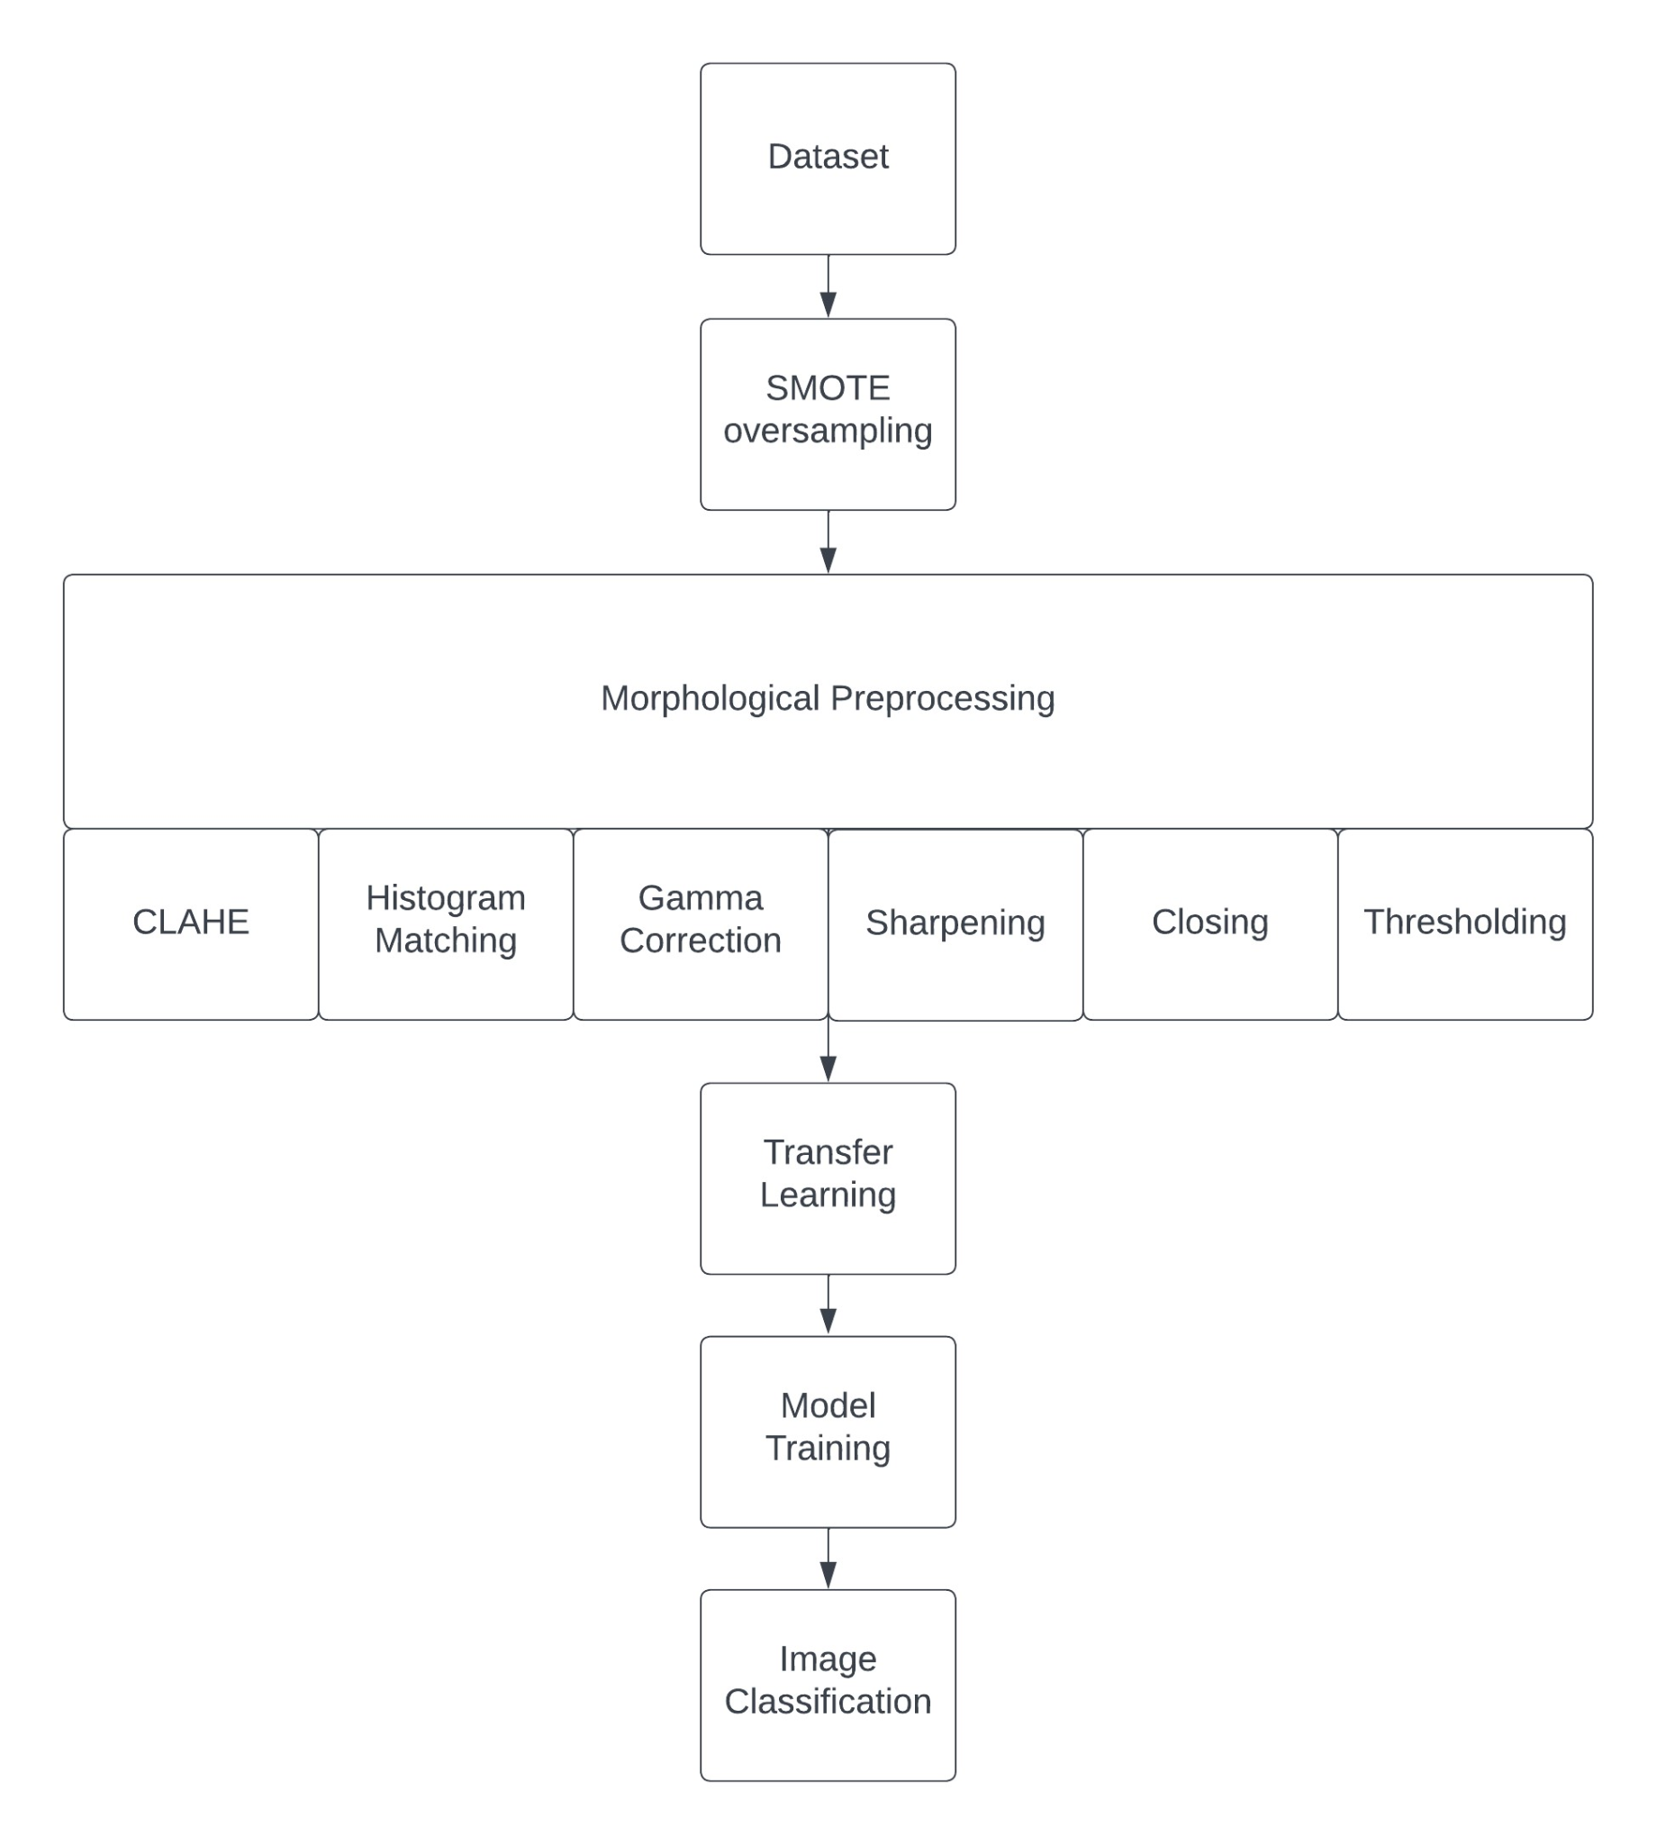
Taxonomy

Slide 6
Shortcomings in the literature survey done
Limited Interpretability:
Many studies lack comprehensive insights into the interpretability of their employed models. The absence of tools such as saliency maps or visualizations may restrict the elucidation of specific image regions critical for diabetic retinopathy classification, hindering the understanding of decision-making processes.
Transparency Challenges:
The current body of research may fall short in providing transparent visualizations of key features influencing model decisions. This lack of transparency poses challenges for clinicians to grasp and trust the automated diagnostic outcomes, impeding the seamless integration of these models into clinical workflows.

Slide 7
Neglect of Model Trustworthiness:
Certain investigations might neglect the critical aspect of ensuring the trustworthiness of the developed models. Failing to enhance the credibility and reliability of diabetic retinopathy classification models could impede their adoption and acceptance in clinical settings, where trust is paramount.
Inadequate Comparative Analysis:
The existing literature may lack comprehensive comparative analyses of various methodologies for diabetic retinopathy classification. This deficiency makes it challenging for researchers and practitioners to discern the most effective approach, hindering the advancement and standardization of methodologies in this critical domain.

Slide 8
Insufficient Clinical Relevance:
Some studies may overlook the importance of focusing on clinically relevant features or fail to provide insights directly beneficial for clinicians in making informed decisions during diabetic retinopathy diagnosis. This limitation potentially diminishes the practical applicability of research findings in real-world clinical scenarios.

Slide 9
Privacy preservation
Privacy preservation is a paramount concern in medical imaging research, particularly in diabetic retinopathy classification. As patient data becomes a focal point for training and validating deep learning models, ensuring robust privacy measures is crucial. The challenge lies in striking a balance between leveraging large-scale datasets for model efficacy and safeguarding sensitive patient information. Advanced techniques, such as federated learning and differential privacy, are pivotal in mitigating privacy risks.
Federated learning enables model training across decentralized devices, minimizing data exposure, while differential privacy introduces noise to individual data points, preserving overall model accuracy without compromising individual privacy.
Emphasizing these privacy-preserving methodologies is essential to foster trust and ethical considerations in the development and deployment of diabetic retinopathy classification systems in healthcare settings.

Slide 10
Dataset problem:
A common challenge in datasets used for diabetic retinopathy classification is the possibility of class imbalance, where specific disease severity stages are inadequately represented. This imbalance has the potential to skew model training, limiting its ability to generalize effectively across all stages of the disease. Moreover, disparities in image quality, resolution, and acquisition devices between datasets can undermine the robustness of the model.
To overcome these dataset challenges and develop dependable and broadly applicable diabetic retinopathy classification models, it is essential to employ techniques such as oversampling and thorough data preprocessing. These strategies aim to ensure fair representation and consistent quality in the training data.

Slide 11
Requirements
Graphics Processing Unit (GPU):
An indispensable component for accelerating the training phase of deep learning models, a dedicated GPU provides parallel processing capabilities that significantly improve performance. This is particularly advantageous for managing the extensive computations associated with training convolutional neural networks (CNNs), especially in image classification tasks.
Retina Scanner:
Critical for obtaining high-resolution retinal images, a CT scanner is a key component in the diagnostic imaging process. By combining computer technology and X-rays, it enables the generation of detailed images necessary for both training and validating deep learning models.

Slide 12
Computer Setup:
A computer system capable of efficiently running the trained model and performing real-time predictions is essential. This includes sufficient processing power, memory, and compatibility with the chosen deep learning framework.

Slide 13
Augmentation Procedures:
To bolster the dataset's strength and diversity, various augmentation techniques are applied:
Rescale:
Adjusts image pixel values by a factor of 1/255.0 to normalize them between 0 and 1, maintaining consistency across the dataset.
Sampling:
Generates synthetic samples by randomly drawing characteristics from occurrences in the minority class.

Slide 14
Fill Mode:
Addresses points outside image boundaries by using the "reflect" mode, promoting continuity and completeness in augmented images.
Validation Split:
Allocates 20% of augmented images for validation, aiding in effective model evaluation and ensuring robust performance.
By integrating these hardware components and augmentation methods, the project aims to optimize model training, ensuring the diabetic retinopathy classification system's reliability and generalizability.

Slide 15
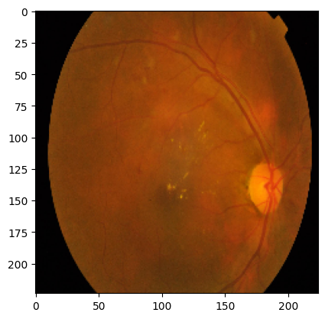
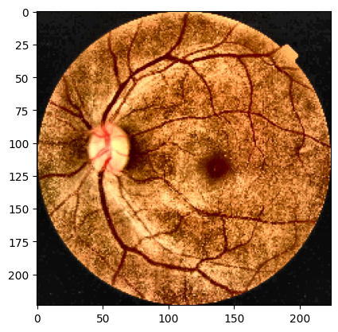
Methodology
Data Collection:
The initial phase involves gathering a diverse dataset with retinal images representing varying degrees of diabetic retinopathy (DR) severity. The dataset is sourced from medical archives to ensure a comprehensive representation of the disease spectrum. Images essential for model training and evaluation are collected through computed tomography (CT) scans, utilizing their diagnostic imaging capabilities to capture detailed retinal structures.
Data Preprocessing:
Acquired images undergo meticulous preprocessing to enhance their quality for effective model learning. A crucial step involves normalization, rescaling pixel values to a range between 0 and 1, ensuring consistent input for subsequent deep learning model training. Contrast enhancement techniques, including Contrast Limited Adaptive Histogram Equalization (CLAHE) and histogram matching, are applied to improve visibility of relevant features within images. Following gamma correction, the output is sharpened, and closing is performed, followed by thresholding to extract eye features. These augmentation strategies aim to enhance model robustness and enable better generalization.

Slide 16
Deep Learning Models:
The core of the methodology involves implementing and evaluating multiple deep learning architectures for diabetic retinopathy classification. Three distinct models are explored to assess their effectiveness in handling the complexity of retinal image classification:
Convolutional Neural Network (CNN):
A baseline CNN is constructed, featuring convolutional layers for feature extraction, max-pooling layers for spatial reduction, and dense layers for classification. This model serves as a benchmark for evaluating the performance of more complex architectures.
Convolutional Neural Network (CNN):
A baseline CNN is constructed, comprising convolutional layers for feature extraction, max-pooling layers for spatial reduction, and dense layers for classification. This model serves as a benchmark for evaluating the performance of more complex architectures.

Slide 17
Transfer Learning with VGG16:
Using transfer learning, a pre-trained VGG16 model is employed as the base, with frozen convolutional layers. Additional layers are added for fine-tuning, followed by a classification head. This approach leverages pre-learned features from a large dataset to enhance the model's ability to discern subtle patterns in retinal images.
U-Net-inspired Architecture:
Inspired by the U-Net architecture, a model is designed to capture intricate details in retinal images. This architecture incorporates upsampling layers for feature reconstruction, enabling a more granular analysis of retinal structures. The U-Net-inspired model is tailored to address the unique challenges posed by diabetic retinopathy classification.

Slide 18
Augmentation Strategies:
Augmentation procedures play a crucial role in diversifying the dataset, promoting improved model generalization. Rescaling of pixel values ensures consistent normalization. Rotation, shifting, zooming, and flipping introduce variations, enriching the dataset with diverse perspectives. The fill mode is used to address boundary points outside the image, enhancing the completeness of augmented images. A validation split of 20% reserves a set for model evaluation, maintaining the integrity of the training-validation framework.
Model Training and Evaluation:
Deep learning models are trained on the augmented and preprocessed dataset. The training process involves iterative optimization of model parameters using backpropagation and gradient descent. Model performance is evaluated using a separate validation set, and hyperparameter tuning is conducted to enhance accuracy and robustness. Evaluation metrics include accuracy, precision, recall, and F1 score. Confusion matrices and classification reports provide comprehensive insights into model performance across different diabetic retinopathy severity stages.

Slide 19
Comparative Analysis:
The final step involves a thorough comparative analysis of the three deep learning models. Models are assessed based on performance metrics, computational efficiency, and practical applicability in clinical settings. This analysis aids in discerning the strengths and weaknesses of each model, guiding the selection of the most effective approach for diabetic retinopathy classification.

Slide 20
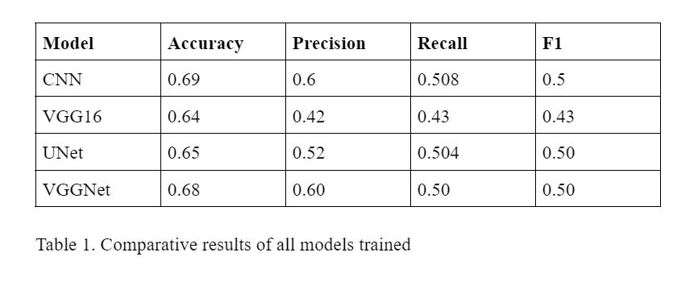
Results:

Slide 21
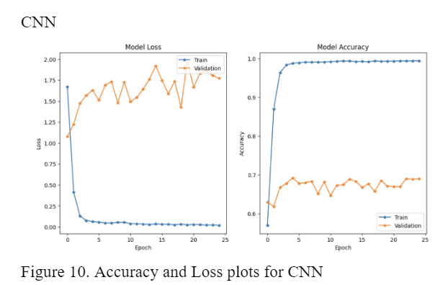

Slide 22
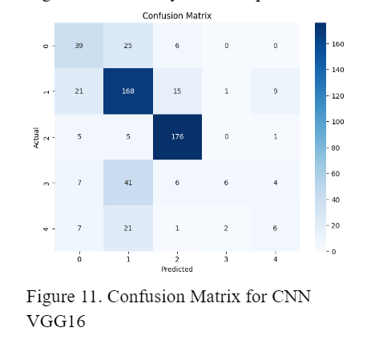

Slide 23
THANK YOU

